Slide 1

Understanding NodeJS
Node.js®
JavaScript runtime built on Chrome's V8 JavaScript engine.
Uses an event-driven, non-blocking I/O model that makes it lightweight and efficient.
Lightweight and efficient, perfect for data-intensive real-time applications.
Run across distributed devices.
NodeJS: https://nodejs.org/

Slide 2
NodeJS
Server Side Development
Client Side Development
Mongodb
Driver for mongo database
Express
Web framework
Jade/Ejs
Server side template like jsp
More…
Grunt/Gulp
Task runner
Yoeman
Scaffolding
Bower
Front end dependency management
More…

Slide 3
NodeJs Vs Traditional approach

Slide 4
Traditional Server Approach
Traditional web-serving techniques
Each connection (request) Spawns a new thread
Takes up system RAM and eventually maxing-out at the amount of RAM available

Slide 5
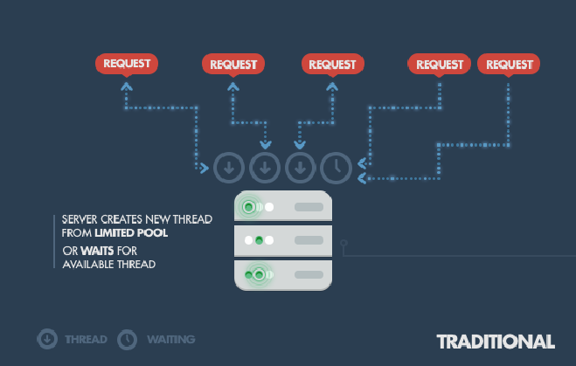
Traditional Server Approach

Slide 6
Traditional Server Approach
Assuming
Each thread potentially has an accompanying 2MB of memory with it
Running on a system with 8 GB of RAM puts us at a theoretical maximum of 4000 concurrent connections
Adds the cost of context-switching between threads.
That’s the scenario you typically deal with in traditional web-serving techniques.

Slide 7

NodeJs approach
Node.js
Operates on a single-thread
Using non-blocking I/O calls
Allowing it to support tens of thousands of concurrent connections

Slide 8
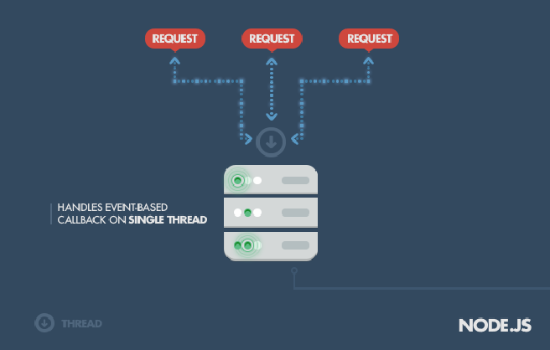
NodeJs approach

Slide 9
NodeJs approach
Node.js achieves scalability levels of over 1M concurrent connections.
Let’s take a very simple piece of code like this:
The execution model of Node.js is different
There is only one single process.
If there is a slow database query somewhere in this process, this affects the whole process
Everything comes to a halt until the slow query has finished.
var result = database.query("SELECT * FROM hugetable");
console.log("Hello World");

Slide 10
NodeJs approach
To avoid this Node.js introduces the concept of event-driven, asynchronous callbacks, by utilizing an event loop.
Node.js can handle the database request asynchronously
Instead of waiting for query to be finished, node makes a mental note that says “When at some point in the future the database query is done, then I have to execute the anonymous function.”
database.query("SELECT * FROM hugetable", function(rows) {
var result = rows;
});
console.log("Hello World");

Slide 11
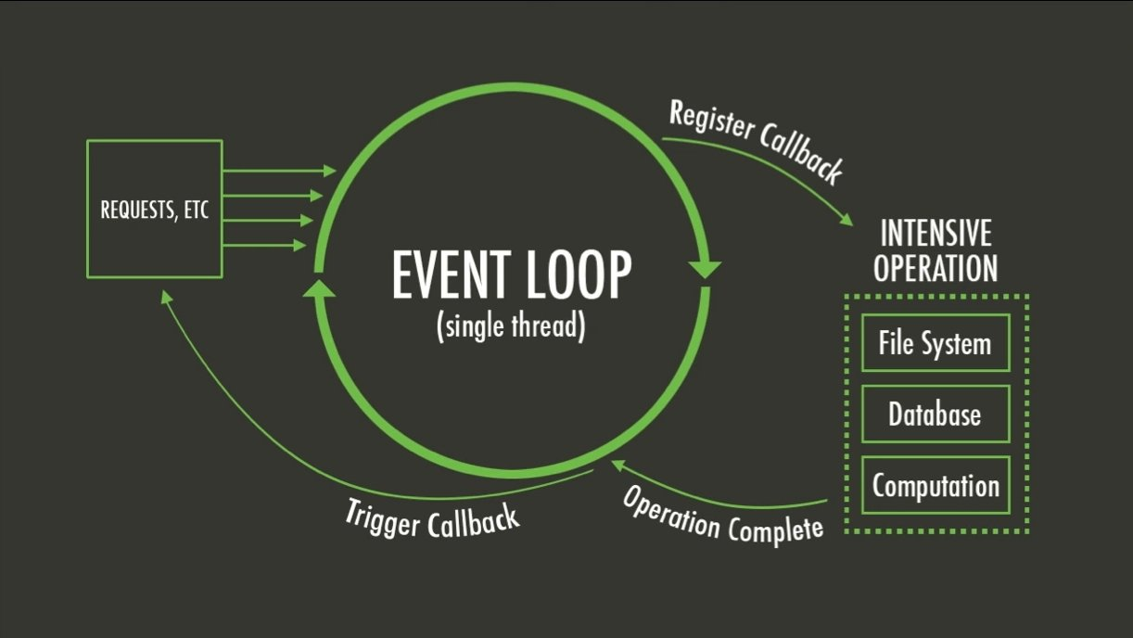
NodeJs approach

Slide 12
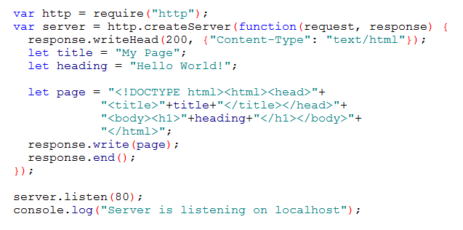
NodeJs server demo

Slide 13
Node Package Manager
Comes by default with every Node.js installation
Built-in support for package management using the NPM tool
A set of publicly available, reusable components, available through easy installation via an online repository, with version and dependency management.
NPM: https://npmjs.org/

Slide 14
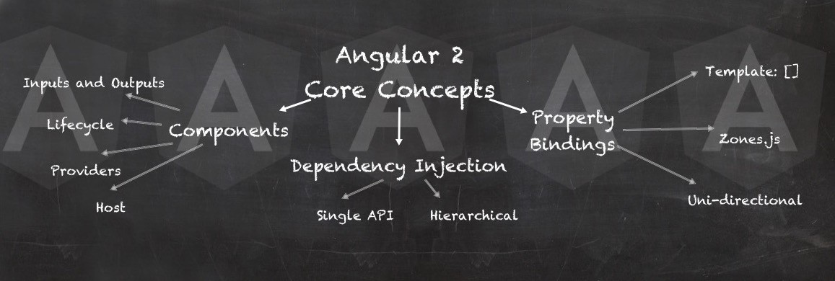
Angular 2

Slide 15
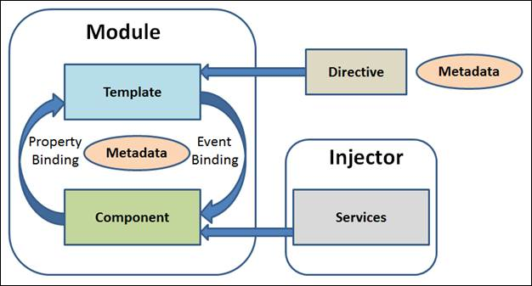
Architecture

Slide 16
Architecture
Module
Component
Template
Metadata
Data Binding
Directive
Service
Dependency Injection

Slide 17
Modules
Good modules are
Highly self-contained with distinct functionality
Allowing them to be shuffled, removed, or added as necessary
Without disrupting the system as a whole.
Good authors divide their books into chapters and sections; good programmers divide their programs into modules.

Slide 18
Why Modules
Maintainability
Updating a single module is much easier when the module is decoupled from other pieces of code.
Namespacing
Modules allow us to avoid namespace pollution by creating a private space for our variables.
Reusability
Let’s be honest here: copy previously written code into new projects.

Slide 19
Angular Module
Every Angular app has at least one Angular module class, the root module.
An Angular module, is a class with an @NgModule decorator.

Slide 20
NgModule
NgModule is a decorator function that takes a single metadata object whose properties describe the module.
declarations - the view classes that belong to this module. [components | directives | pipes]
imports - other exported modules needed by this module component templates. [BrowserModule | FormModule]
providers - services become accessible in all parts of this module. [HttpService | LoggerService]
bootstrap - the main application view, called the root component, that hosts all other app views. Only the root module should set this bootstrap property. [AppComponent]

Slide 21
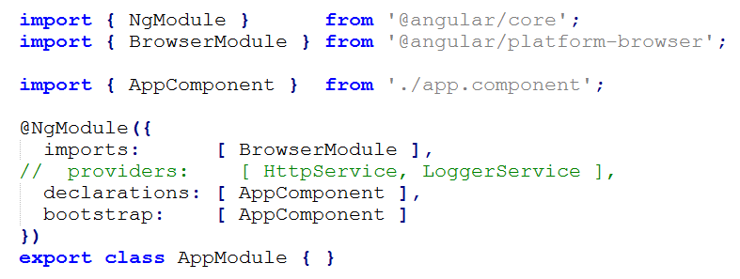
NgModule

Slide 22
Why Components
Developers have been trying to find a solution to architecture on complex web applications.
The most recent answer to that are components
Divide the interface in smaller and autonomous blocks to achieve maintainability and scalability.
Autonomous = Independent and having the power to make own decisions

Slide 23
Component
A controller class with a template which mainly deals with a view of the application and logic on the page.
@Component annotation is used to register component.
There will be only one component per DOM element.

Slide 24
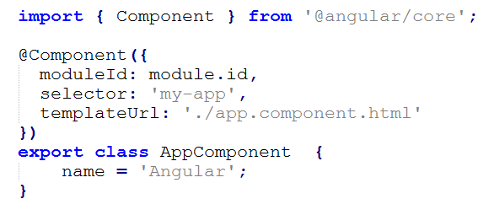
Component

Slide 25
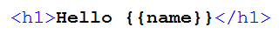
Template
Defines a component's view with its companion template.
A form of HTML that tells Angular how to render the component.
app.component.html

Slide 26
Metadata
A way of processing the class.
Consider a class called MyComponent.
How would angular recognize it as component.
Metadata (@Component decorator) is used to the class to tell Angular that MyComponent is a component.

Slide 27
Metadata
@Component configuration options:
moduleId: sets the source of the base address [module.id]
selector: html selector that tells Angular to create and insert an instance of this component. For example, if an app's HTML contains <app-root></app-root>, then Angular inserts an instance of the AppComponent view between those tags.
template/templateUrl: module-relative address of this component's HTML template.
providers: array of dependency injection providers for services that this component requires.

Slide 28
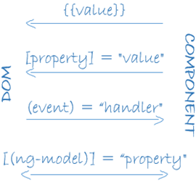
Data Binding
Mechanism for coordinating parts of a template with parts of a component
Pushes data values into the HTML from logic.

Slide 29
Data Binding
Interpolation: Displays the component's property value within the HTML element.
Property Binding: It passes the property from the parent to the child.
Event Binding: It fires the event.
Two-way Binding: This form binds property and event by using the ngModel directive in a single notation.

Slide 30
Directive
Makes angular templates dynamic.
Before Angular renders template, directives gives the instructions to angular to transforms the DOM.
A class with a @Directive decorator
They tend to appear within an element tag as attributes
A component is a directive-with-a-template; a @Componentdecorator is actually a @Directive decorator extended with template-oriented features.

Slide 31
Directive
Kinds of directives are
Structural directives
ngIf, ngFor, ngSwitch
Attribute directives
ngClass, ngStyle, ngModel

Slide 32
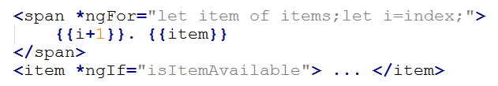
Structural Directive
Alter layout by adding, removing, and replacing elements in DOM

Slide 33
Attribute Directive
Alter the appearance or behavior of an existing element
ngModel directive an example of an attribute directive, modifies the behavior of an existing element
by setting its display value property and responding to change events

Slide 34
Component Vs Directive
Component | Directive
Component is a directive with View. | Directives don’t have View.
Component is used to break up the application into smaller elements. | Directives is used to add behavior to an existing DOM element/component.
To register component we use @Component meta-data annotation. | To register directives we use @Directive meta-data annotation.

Slide 35
Service
Provides anything our application needs.
Shares data or functions.
Injected using Dependency Injection mechanism.
Singleton class responsible for doing a specific task only such as
Logging service
Data service
Message service
The configuration of application
More…

Slide 36
Service

Slide 37
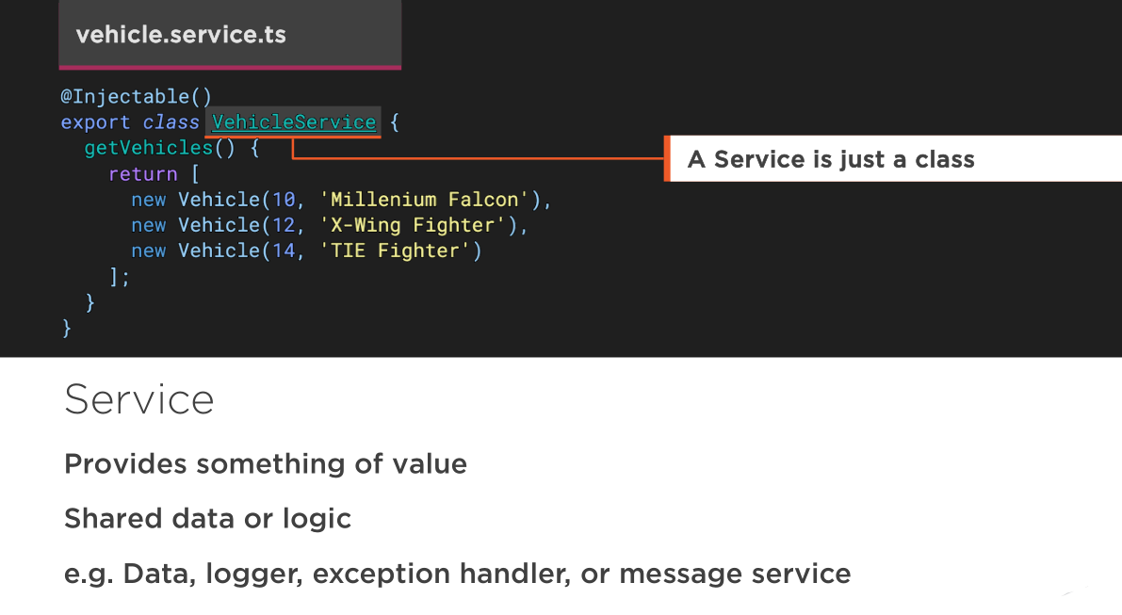
Service

Slide 38
Dependency Injection
A design pattern that passes an object as dependencies in different components across the application.
Creates new a instance of class along with its required dependencies.

Slide 39
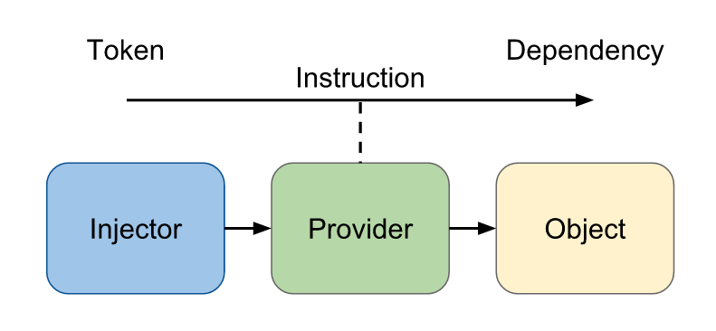
Dependency Injection

Slide 40
Pipe
Pipes transform displayed values within a template.
Built-in pipes
DatePipe
UpperCasePipe
LowerCasePipe
CurrencyPipe and
PercentPipe
No FilterPipe and OrderByPipe
Notes:
https://angular.io/docs/ts/latest/guide/pipes.html#!#no-filter-pipe

Slide 41
Pipe

Slide 42
Pipe

Slide 43
Pipe

Slide 44
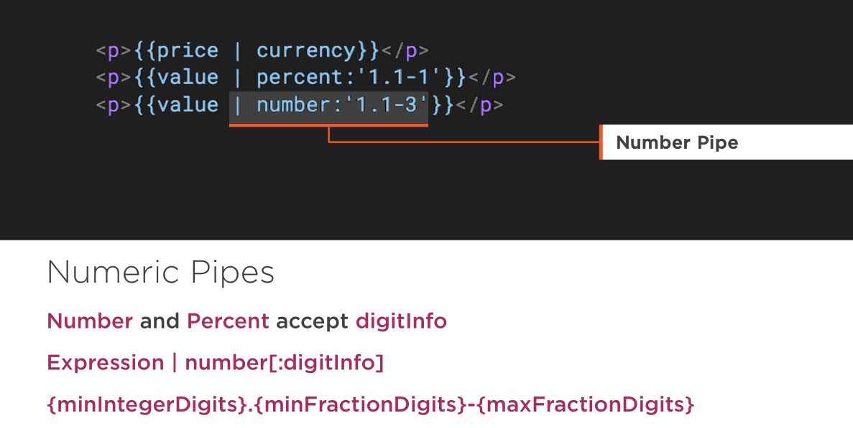
Pipe

Slide 45
Pipe
Async Pipe
Subscribes to a Promise or an Observable, returning the latest value emitted

Slide 46
Pipe

Slide 47
Form

Slide 48
Form
A form creates a cohesive, effective, and compelling data entry experience.
An Angular form coordinates a set of data-bound user controls, tracks changes, validates input, and presents errors.

Slide 49
Form: Crucial & Complex
Forms seem straightforward:
you make an input tag
the user fills it out
and hits submit
How hard could it be?

Slide 50
Form
Form can end up being really complex
Form inputs are meant to modify data, both on the page and the server
Changes often need to be reflected elsewhere on the page
Users have a lot of leeway in what they enter, so you need to validate values
The UI needs to clearly state expectations and errors, if any
Dependent fields can have complex logic
We want to be able to test our forms, without relying on DOM selectors

Slide 51
Form
Thankfully, Angular2 has tools to help with all of above things.
FormControls
encapsulate the inputs in our forms and give us objects to work with them
Validators
give us the ability to validate inputs, any way we'd like
Observers
let us watch our form for changes and respond accordingly

Slide 52
FormControls
Represents a single input field
Smallest unit of an Angular form
Encapsulate the field's value, and states such as if it is valid, dirty (changed), or has errors

Slide 53
FormGroups
Most forms have more than one field
we need a way to manage multiple FormControls
If we want to check the validity of our form
iterate over an array of FormControls and check each FormControl for validity.
FormGroups solve this issue by providing a wrapper interface around a collection of FormControls

Slide 54
FormGroups
Here's how you create a FormGroup:

Slide 55
FormModules
In order to use the new forms library we need to first import the forms library in our NgModule
Template driven directives
Data driven directives
Notes:
There is an exception: NgForm won't be applied to a <form> that has formGroup.
form:not([ngNoForm]):not([formGroup]),ngForm,[ngForm]
This means you could have a form that doesn't get NgFormapplied by using the ngNoForm attribute.

Slide 56
Form & NgForm
There are two important pieces of functionality that NgForm gives us:
A FormGroup named ngForm
A (ngSubmit) output

Slide 57
FormBuilder
A more flexible and common way to configure forms is to use a FormBuilder
Forms are made up of FormControls and FormGroups
The FormBuilder helps us make them
Think of it as a "factory" object

Slide 58
FormBuilder
FormBuilder.control - creates a new FormControl
FormBuilder.group - creates a new FormGroup

Slide 59
Steps for Template Driven
1. ngModels to the input boxes -- read value 2. ngSumit and ngForm 3. HTML5 input validations 4. ng-invalid and ng-valid css classes 5. [ngModel] to pick the default values, but one way binding 6. [(ngModel)] two way binding 7. FormGroup ngModelGroup="userData" 8. Radio button 9. Form state, valid form

Slide 60
Steps for Data Driven
1. Create Form Group and Form Controls 2. Synchronize the form with data-driven comp and bind the FormControls 3. submit the form and log form value on the console 4. Add validations to the FormControls 5. If email is invalid show error message 6. If form is invalid don't let the user submit it 7. Group Data - Nested Form Group 8. Bind radio type 9. Custom Validation 10. Form Array 11. Add data in FormArray 12. Async validation

Slide 61
Server Side Communication

Slide 62
HTTP
We use Http to get and save data with Promises or Observables. We isolate the http calls in a shared Service.

Slide 63
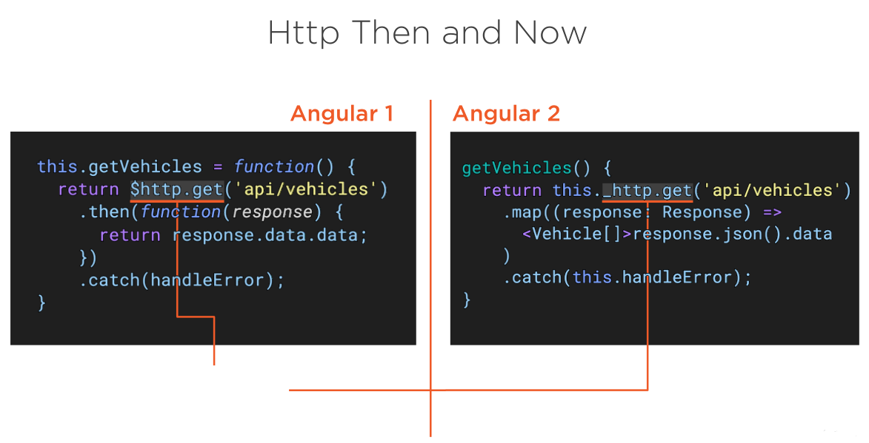
HTTP

Slide 64
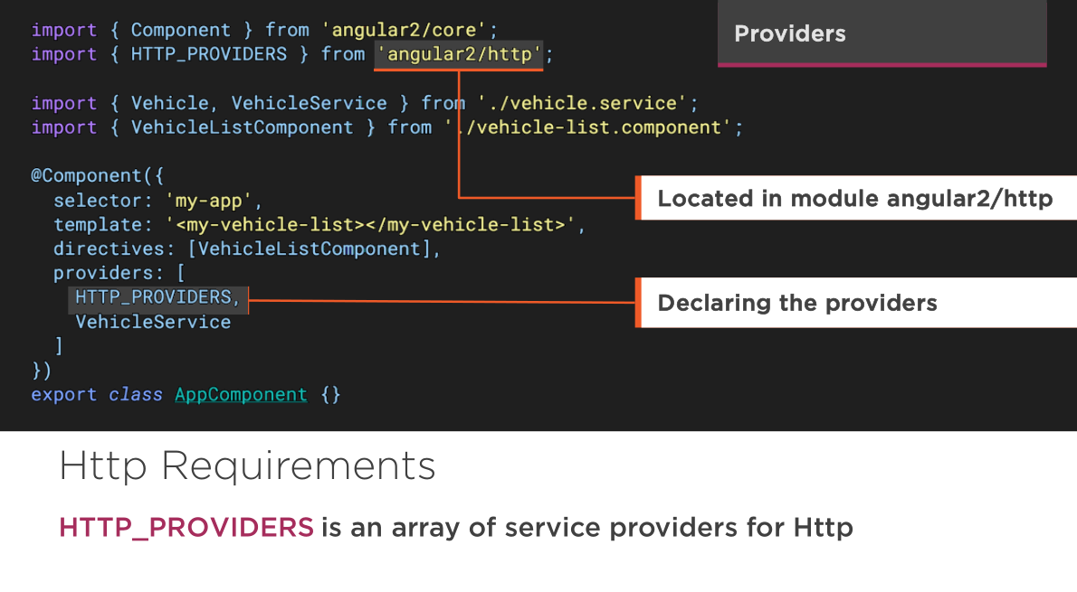
HTTP-verson rc

Slide 65
HTTP-latest version

Slide 66
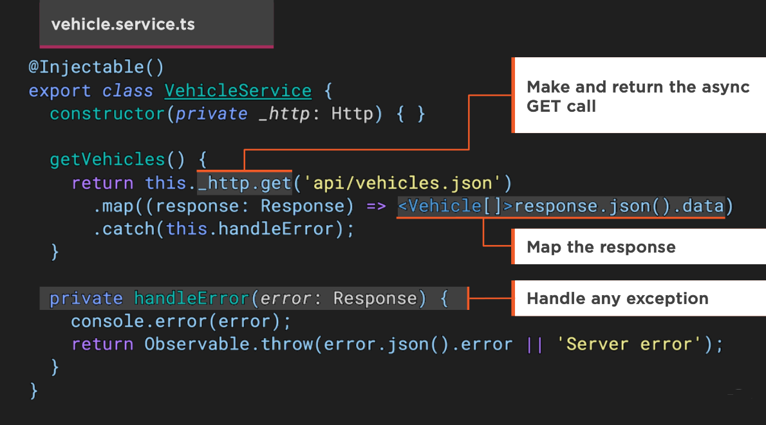
HTTP

Slide 67
HTTP

Slide 68
HTTP

Slide 69
HTTP
RxJx
RxJx (Reactive Js) implements the asynchronous observable pattern and is widely used in Angular 2

Slide 70
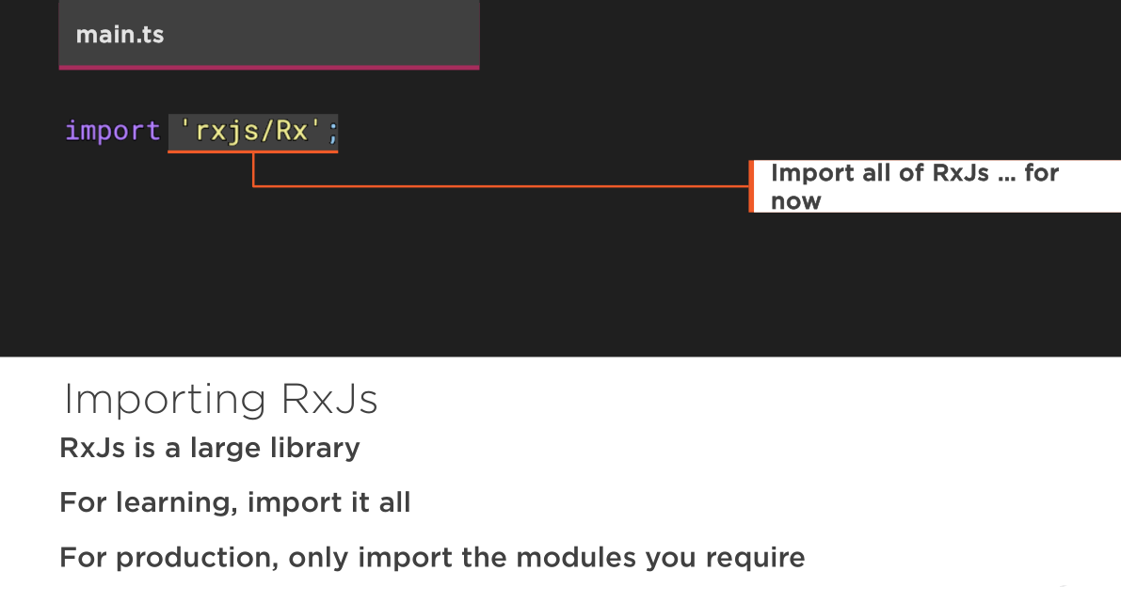
HTTP

Slide 71
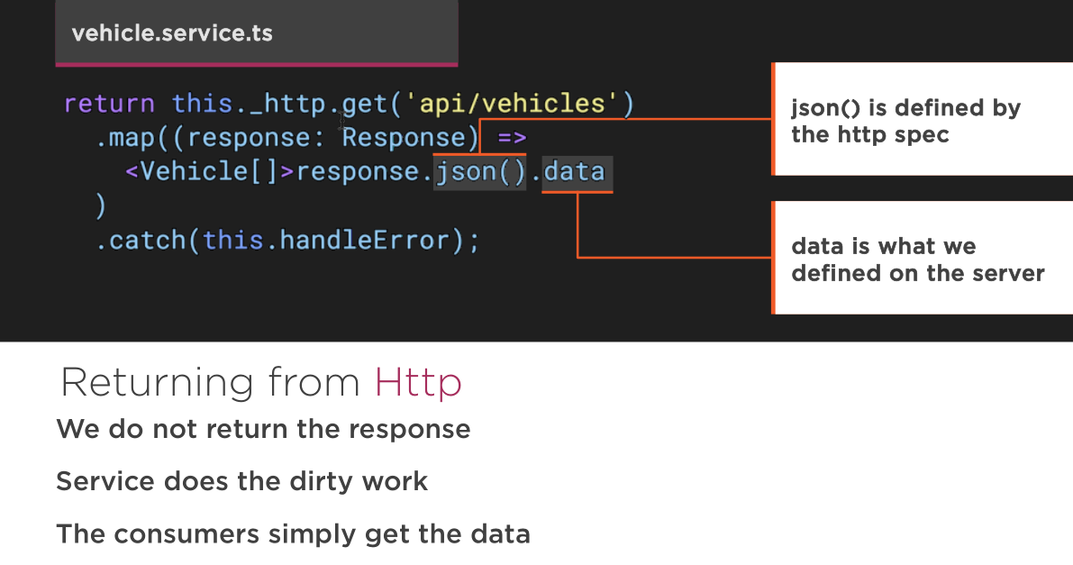
HTTP

Slide 72
HTTP

Slide 73
HTTP

Slide 74
Single Page App

Slide 75
Routing
Routing allows our application to navigate between different Components, passing parameters where needed

Slide 76
Routing
Route Configuration
Router Outlets
Router Links
Route Parameters
Child Routers

Slide 77
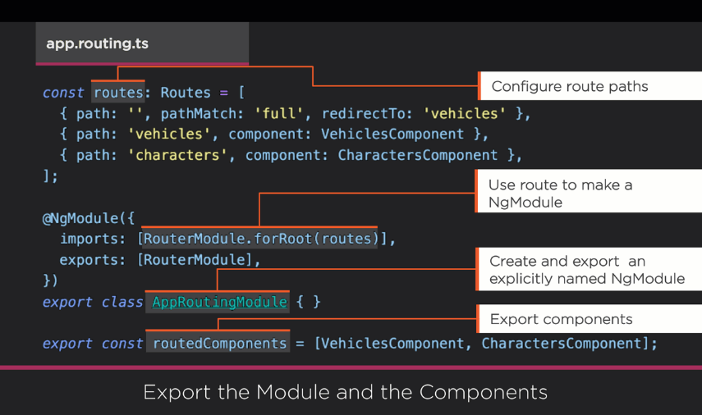
Routing

Slide 78
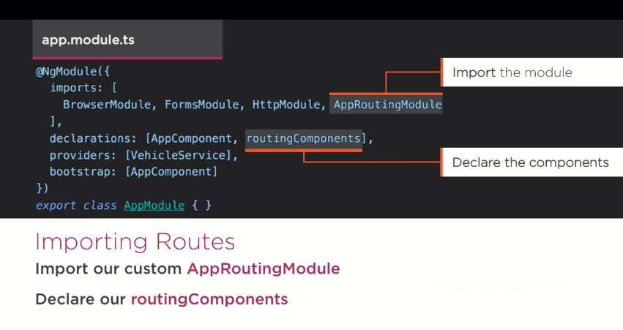
Routing

Slide 79
Routing

Slide 80
Template

Slide 81
NgIf Case Study
It takes a boolean and makes an entire chunk of DOM appear or disappear. Really ??
<h2 *ngIf="condition">
Visible if condition is true.
</h2>
<h2 *ngIf="!condition">
Visible if condition is false.
</h2>
The ngIf directive does not hide the element.
Disused h2 is completely absent from the DOM!
With css from component

Slide 82
Why remove rather than hide?
When we hide an element
cons
The component's behavior continues.
Remains attached to its DOM element.
Continues to listen to events.
Angular keeps checking for changes that could affect data bindings.
Whatever the component was doing it keeps doing.
Tie up resources that might be more useful elsewhere.
The performance and memory burden can be substantial.
pros
Showing the element again is very quick
Component doesn't re-initialize
Notes:
With ngIf, angular2 removes the element from DOM, stops change detection for the associated component, detaches it from DOM events and destroys the component.

Slide 83
NgIf
With *ngIf=true, Angular
removes the element from DOM
stops change detection for the associated component
detaches it from DOM events
destroys the component
All child components are destroyed when ngIf destroys the common ancestor
I want that particular component again soon.

Slide 84
NgIf
Of course it isn't always a good thing
It might be a bad thing if we need that particular component again soon.
The component's state might be expensive to re-construct
When ngIf becomes true again
Angular recreates the component and its subtree
Angular runs every component's initialization logic again
That could be expensive

Slide 85
How to use ngIf
Design thought:
Minimize initialization effort and consider caching state in a companion service

Slide 86
Why remove rather than hide?
Although there are pros and cons to each approach
In general it is best to use ngIf to remove unwanted components rather than hide them.
These same considerations apply to every structural directive, whether built-in or custom.
Notes:
If we really expected to "wink" the component like this, toggling visibility would be the better choice. In most UIs, when we "close" a component we're unlikely see it again for a long time, if ever. The ngIf would be preferred in that case.

Slide 87
Template

Slide 88
Template

Slide 89
The <template> tag
Structural directives, like ngIf, do their magic by using the HTML 5 template tag.
Outside of an Angular app, the <template> tag's default CSS display property is none. It's contents are invisible within a hidden document fragment.
Inside of an app, Angular removes the <template> tags and their children. The contents are gone

Slide 90
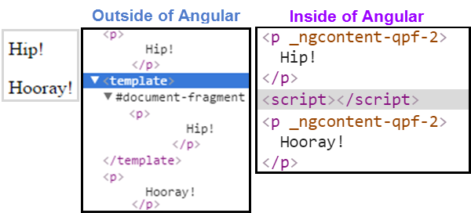
The <template> tag
<p>
Hip!
</p>
<template>
<p>
Hip!
</p>
</template>
<p>
Hooray!
</p>

Slide 91
The asterisk (*) effect
We're prefixing these directive names with an asterisk (*).
The asterisk is "syntactic sugar".
It simplifies ngIf and ngFor for both the writer and the reader
Under the hood, Angular replaces the asterisk version with a more verbose <template> form.

Slide 92
<!-- Examples (A) and (B) are the same -->
<!-- (A) *ngIf paragraph -->
<p *ngIf="condition">
Our heroes are true!
</p>
<!-- (B) [ngIf] with template -->
<template [ngIf]="condition">
<p>
Our heroes are true!
</p>
</template>

Slide 93
ShadowDOM

Slide 94
Hello, Shadow World
Elements can gets a new kind of node associated with them.
This new kind of node is called a shadow root
Element that has a shadow root associated with it is called a shadow host
The content of a shadow host isn’t rendered
Content of the shadow root is rendered instead.

Slide 95
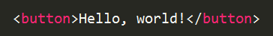
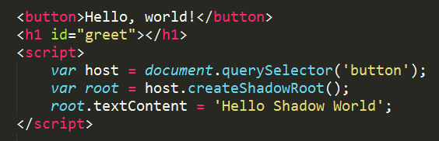
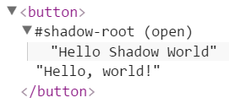
Shadow World
DOM

Slide 96
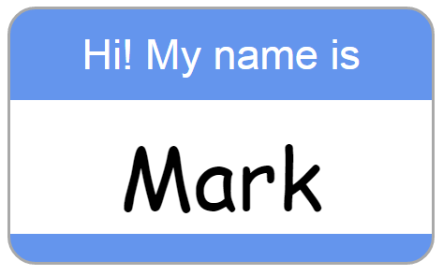
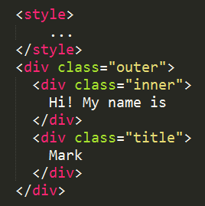
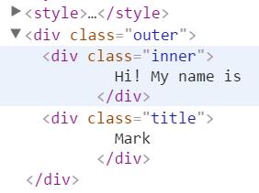
Shadow World
Browser
File.html
DOM

Slide 97
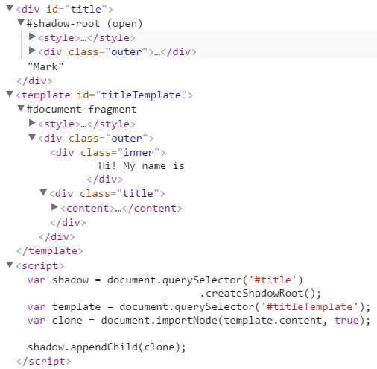
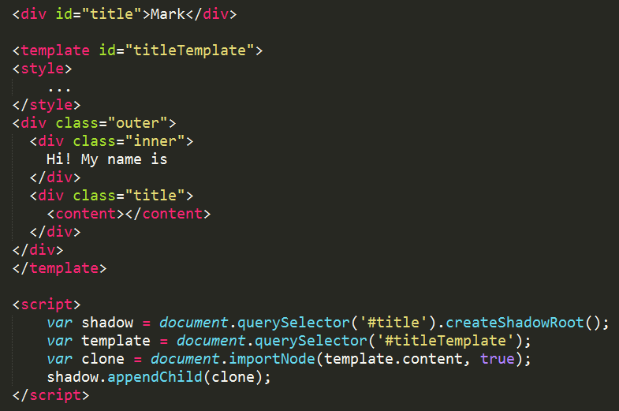
Shadow World
DOM
File.html
Browser

